Slide 1
A IBe Electronics Company
MBA
CAPABILITIES
Revision: Apr 2019

Slide 2
MBA Electronics, Inc.
A IBe Electronics Company
With over 30 years in business, MBA Electronics has established itself as a premier US Based manufacturer and designer of products and components, which are designed & manufactured here in the U.S. or abroad at our state-of-the-art Shenzhen, China Parent company factory, IBE Electronics Co, Ltd.
Our customers work closely with our U.S. support teams, including our China-based manufacturing and engineering teams to ensure the products we manufacture or design, are of the highest quality.
MBA has been long known for it’s high quality of PCB manufacturing and OEM design capabilities, with two decades of success, we’ve pioneered ourselves around traditional high-precision and high-quality manufacturing morals.

Slide 3
Mission Statement
To exceed our customers expectations in quality, delivery, and cost through continuous internal improvement, commitment, responsibility and customer interaction.

Slide 4
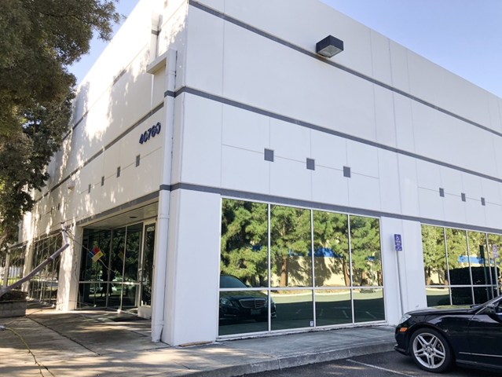
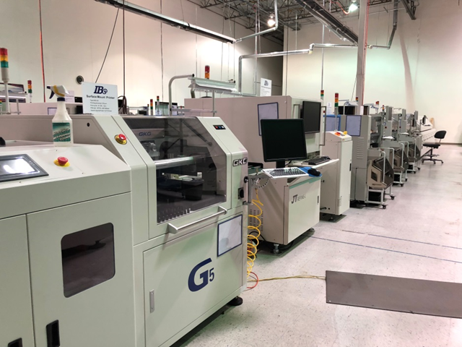
MBA ELECTRONICS
MBA Electronics
IBE Electronics
Parent Company of MBA
Sales & Design/Engineering Support center
Hillsboro, OR
-PCB Factory
Fujian China
EMS Factory
Electrical Design Support & Testing
Fremont, CA
-Branch office
Hong Kong
-PCB/PCBA
-Injection Mold
-Product Assembly
Shenzhen China

Slide 5
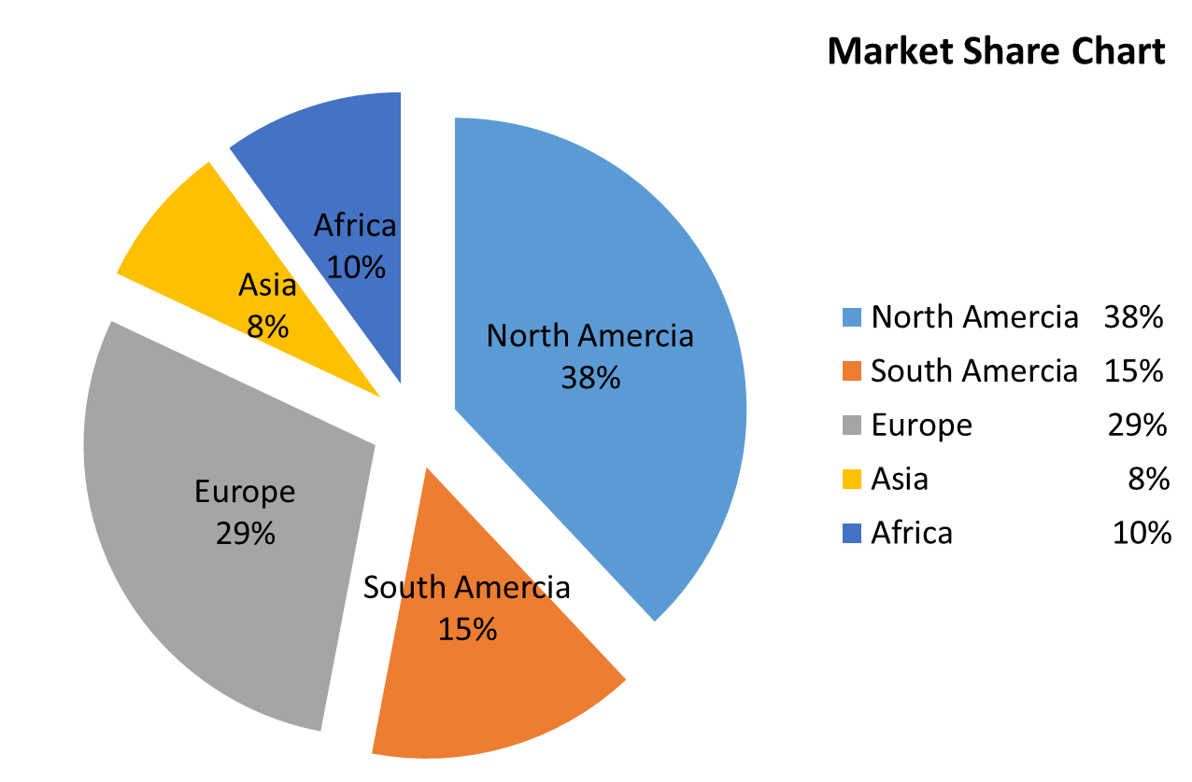
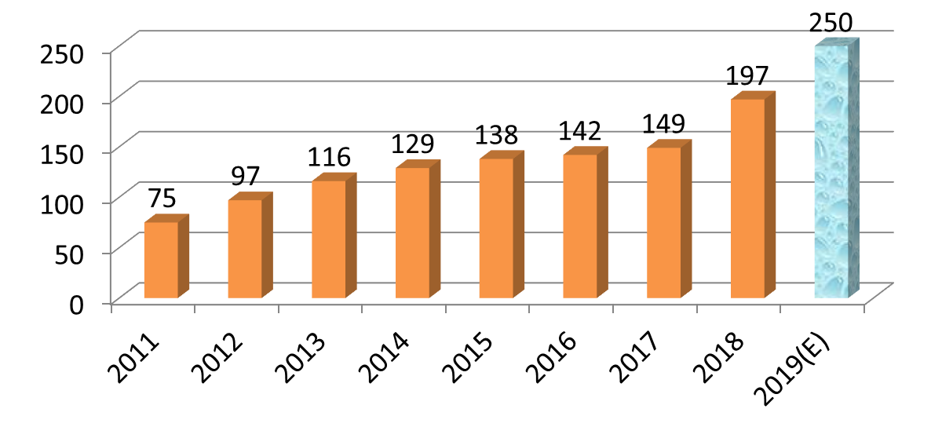
Global Customer Overview
Turnover in USD Millions

Slide 6
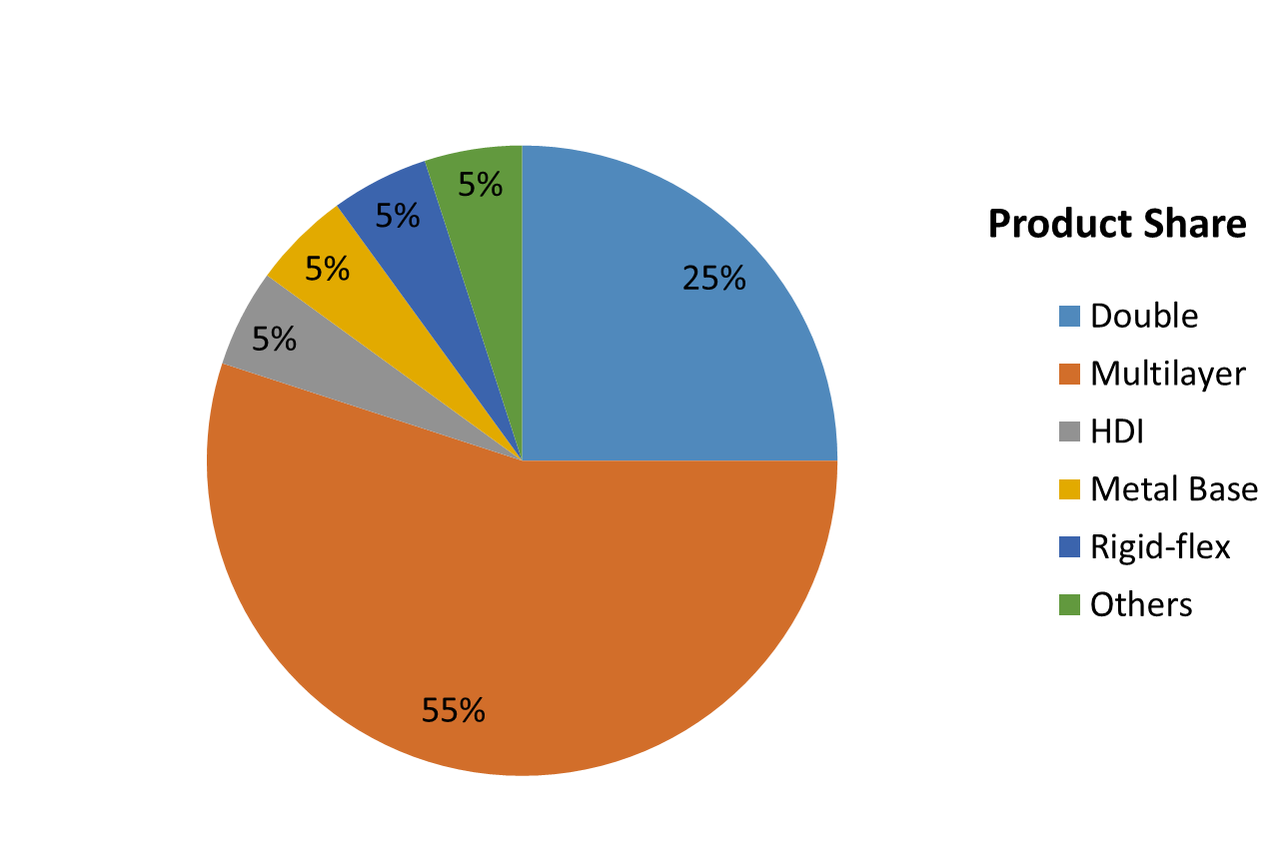
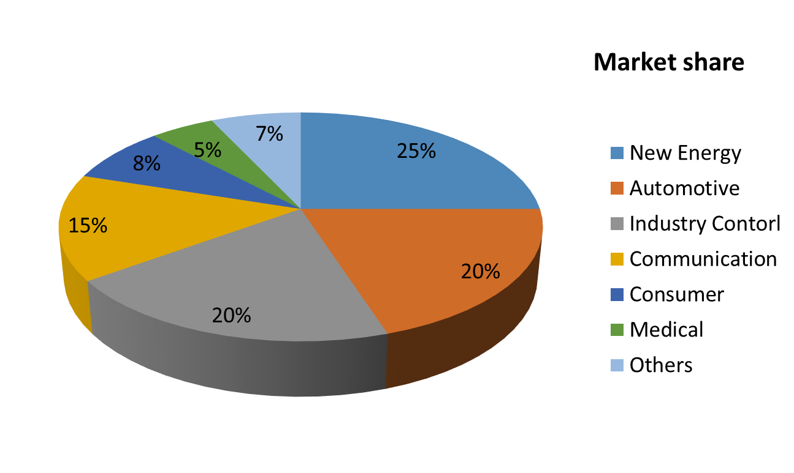
Market & Product Share

Slide 7
Capabilities Introduction
R&D
Design & Engineering Services
PCB
PCB Fab + Assembly, 2-16 layers
Turnkey
Full Product Design & Assembly
Customer Support
Direct factory customer support
Optical Design
Mechanical Design
Electrical Design
Software
X14 SMT LINES
Strong Parts & Components sourcing teams
Injection Molding
Multiple assembly & testing lines
US Support team
China direct support team
US support team
Quick-turn options
No minimum order
IPC Class II and III capabilities
Firmware
Quick-turn prototyping
Division support teams

Slide 8
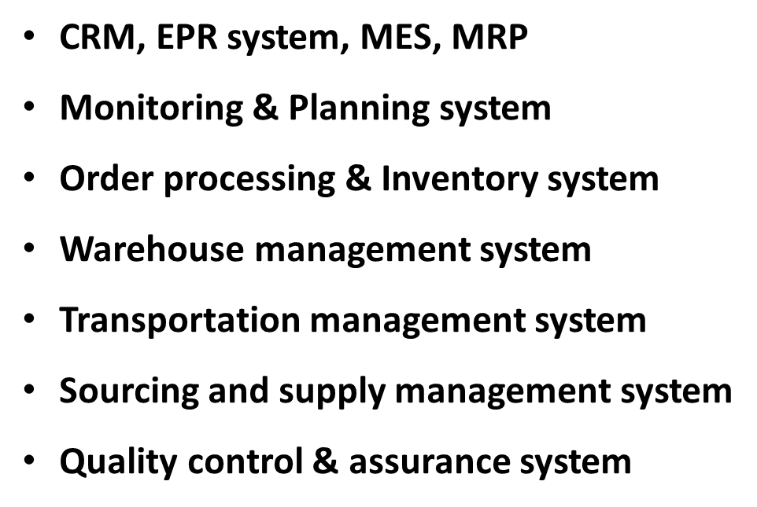
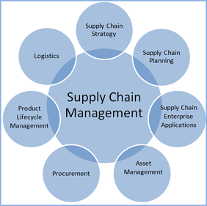
Capabilities Supply Chain Management

Slide 9
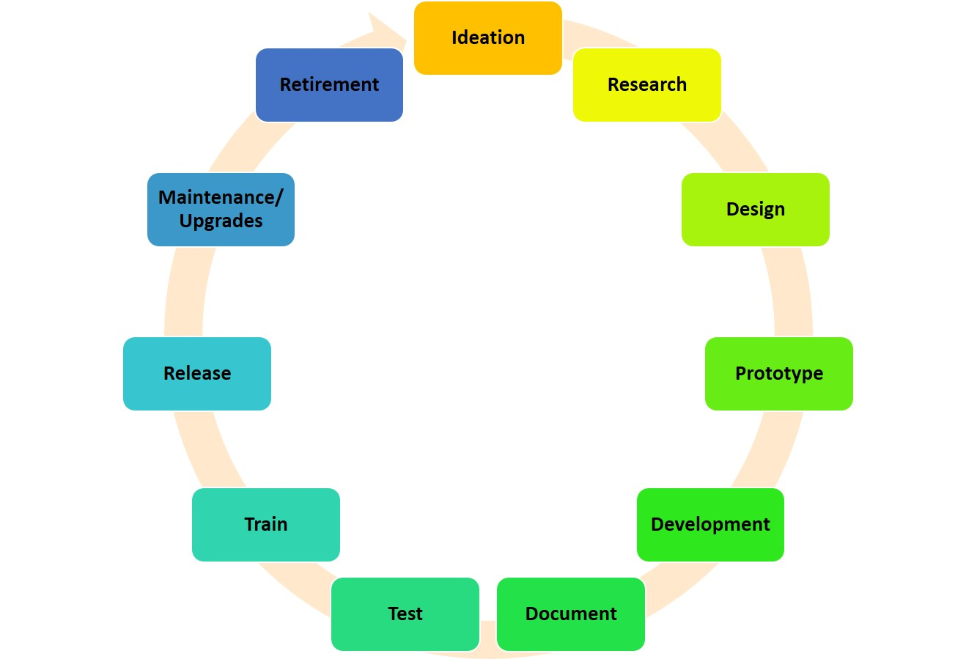
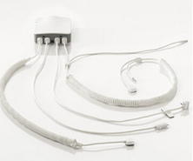
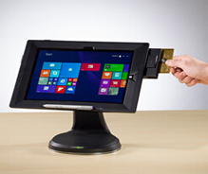
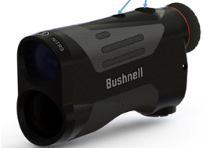
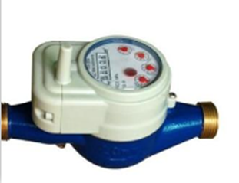
Capabilities R&D – Design & Engineering Services
OEM Design Services Provided in a wide-area of; Optics,
Security, Healthcare, Automotive and Medical Devices.
Large staff of 55 experienced engineers,
Hardware, Software, Mechanical, Electrical & Optical.
Our Engineering staff can support your new or existing designs.
Below are examples of some of our capabilities:

Slide 10
Main Raw Material Partners

Slide 11
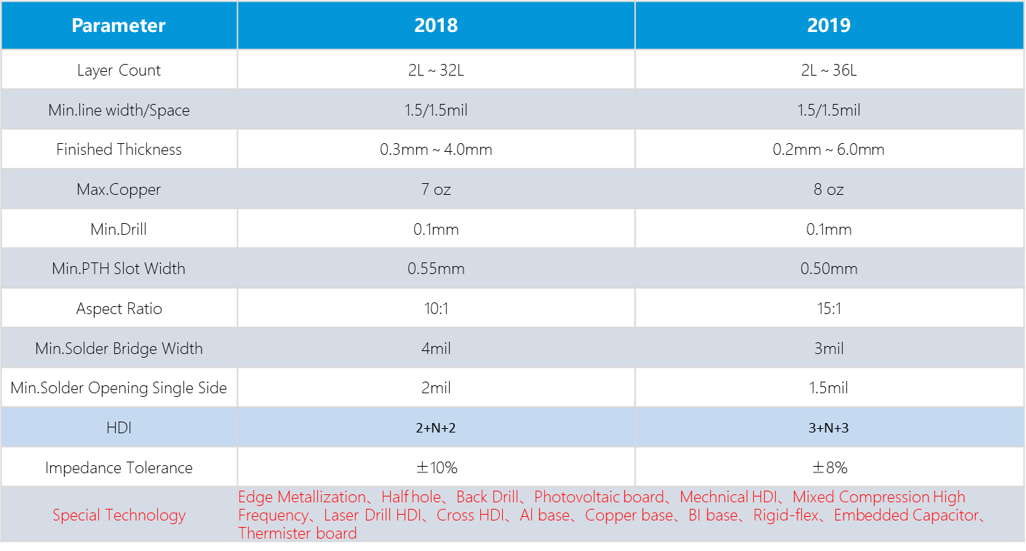
PCB Capability Growth

Slide 12
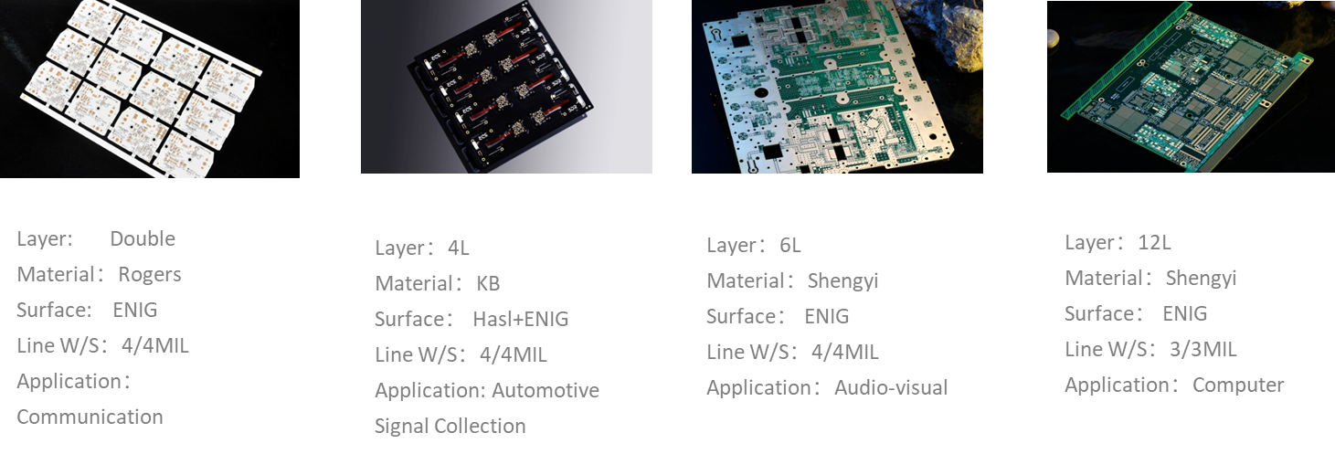
PCB Samples

Slide 13
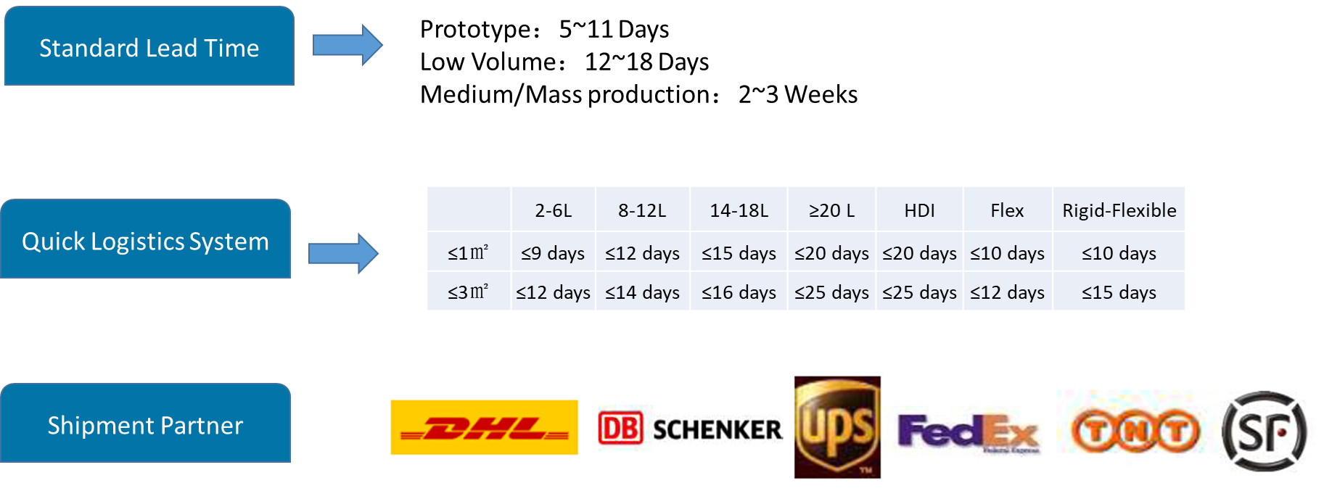
Delivery Lead-times

Slide 14
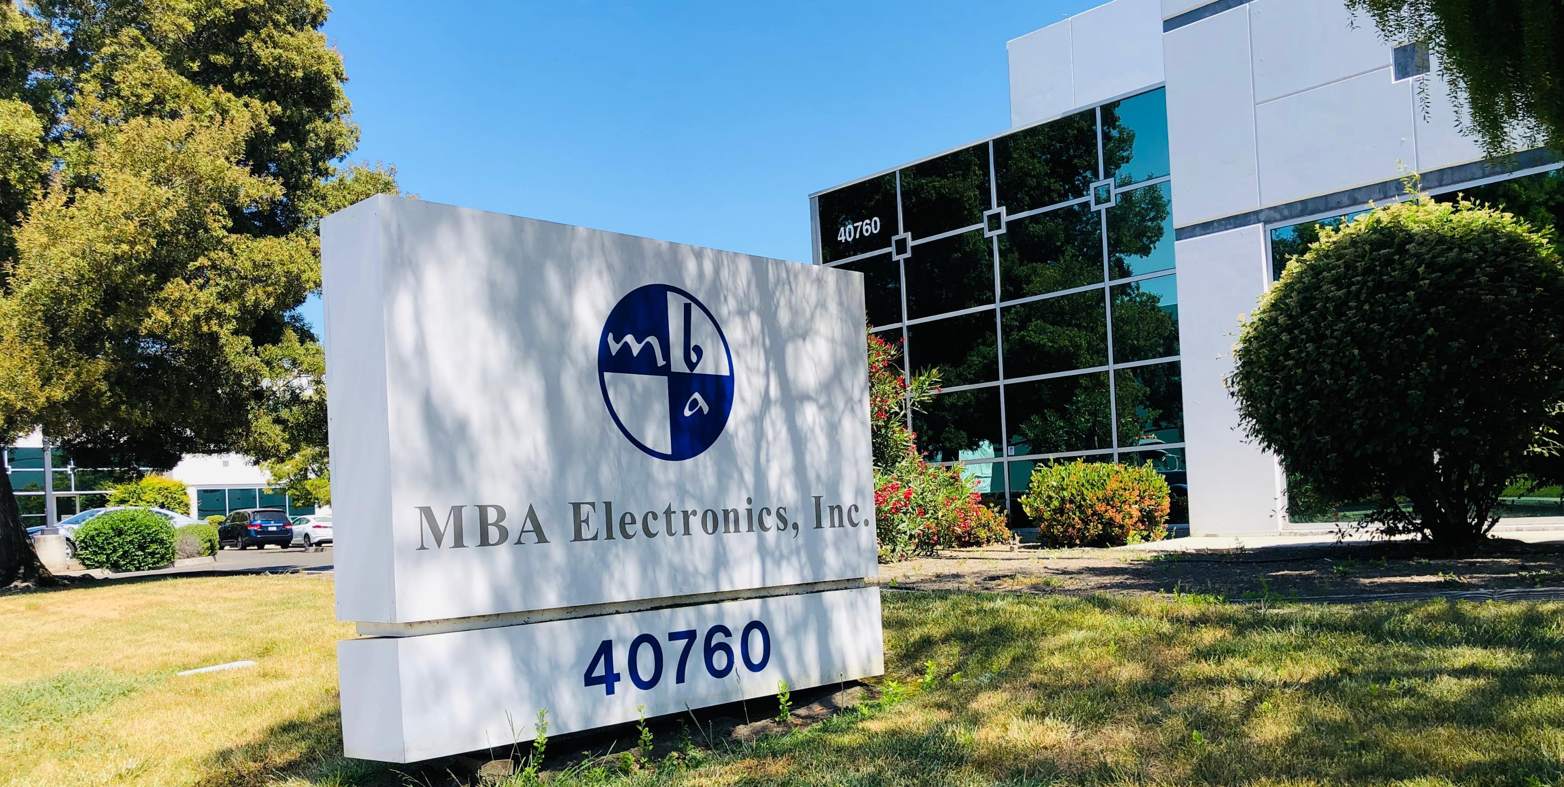
MBA Electronics Facility

Slide 15
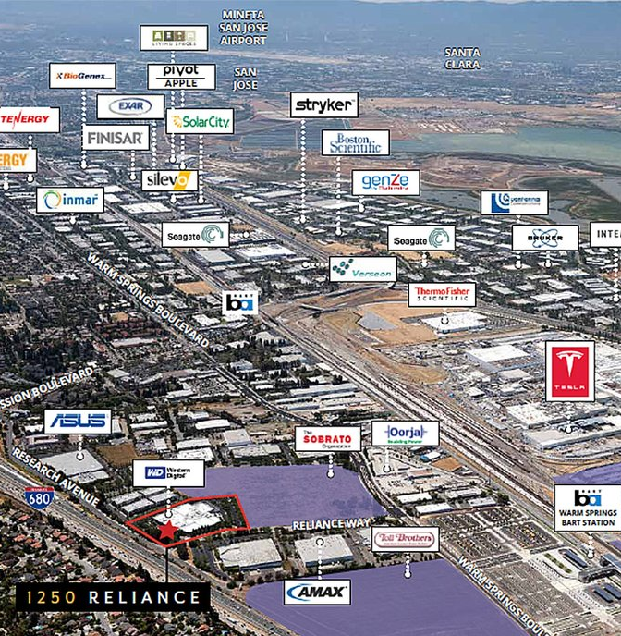
Silicon Valley – Fremont, CA

Slide 16
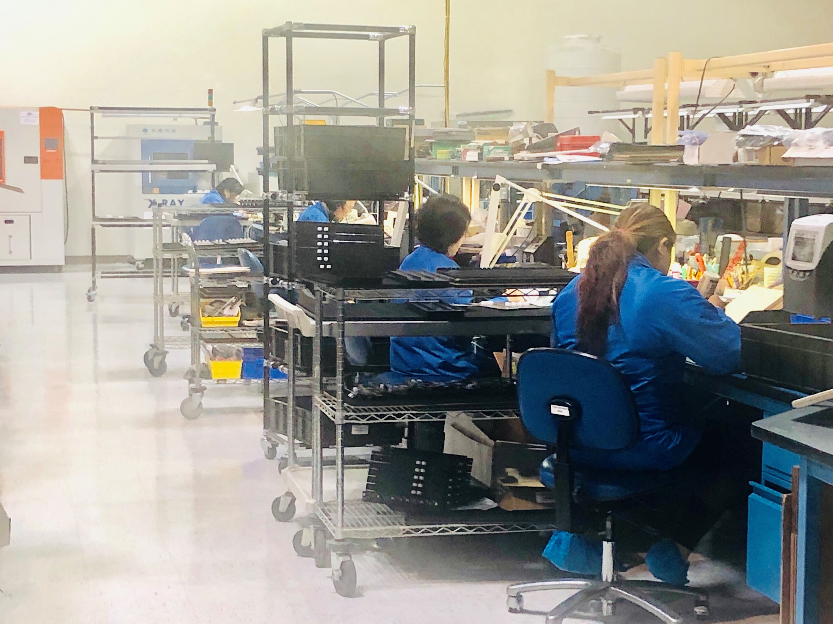
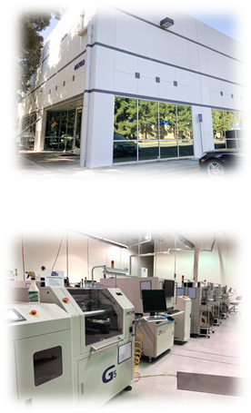
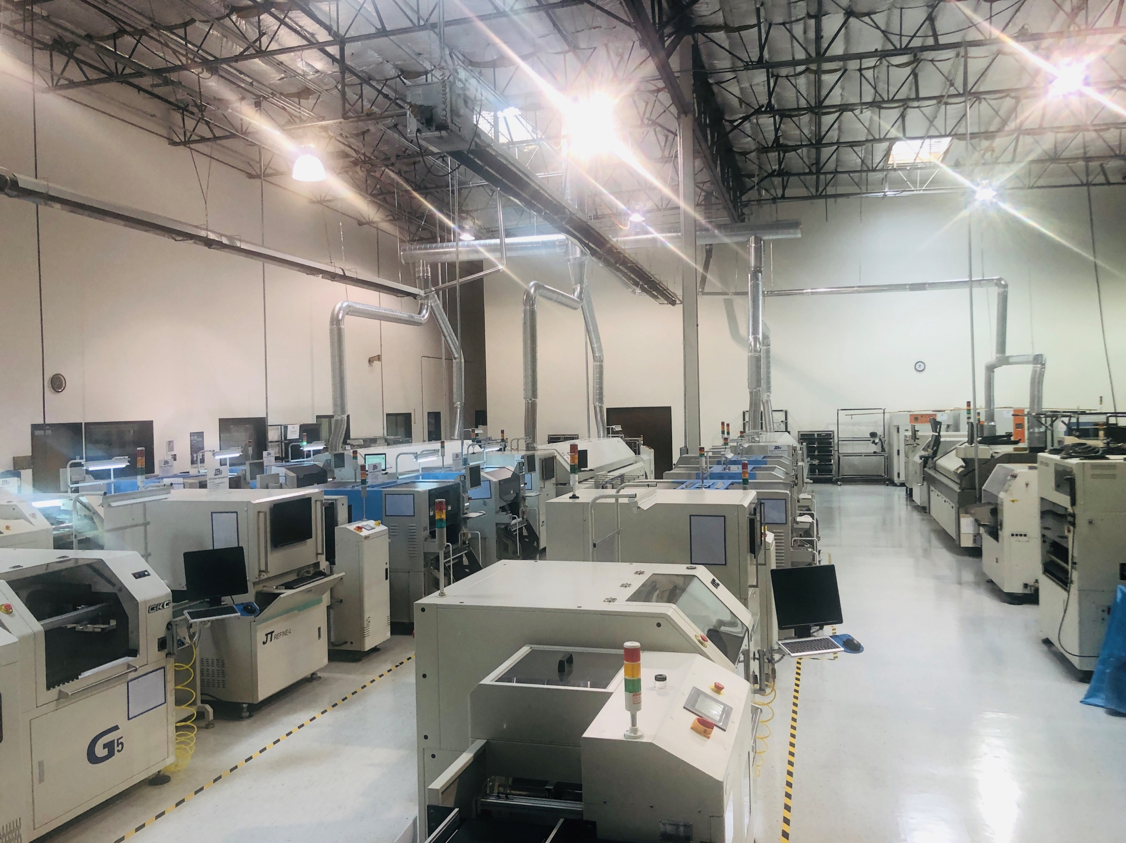
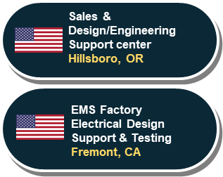
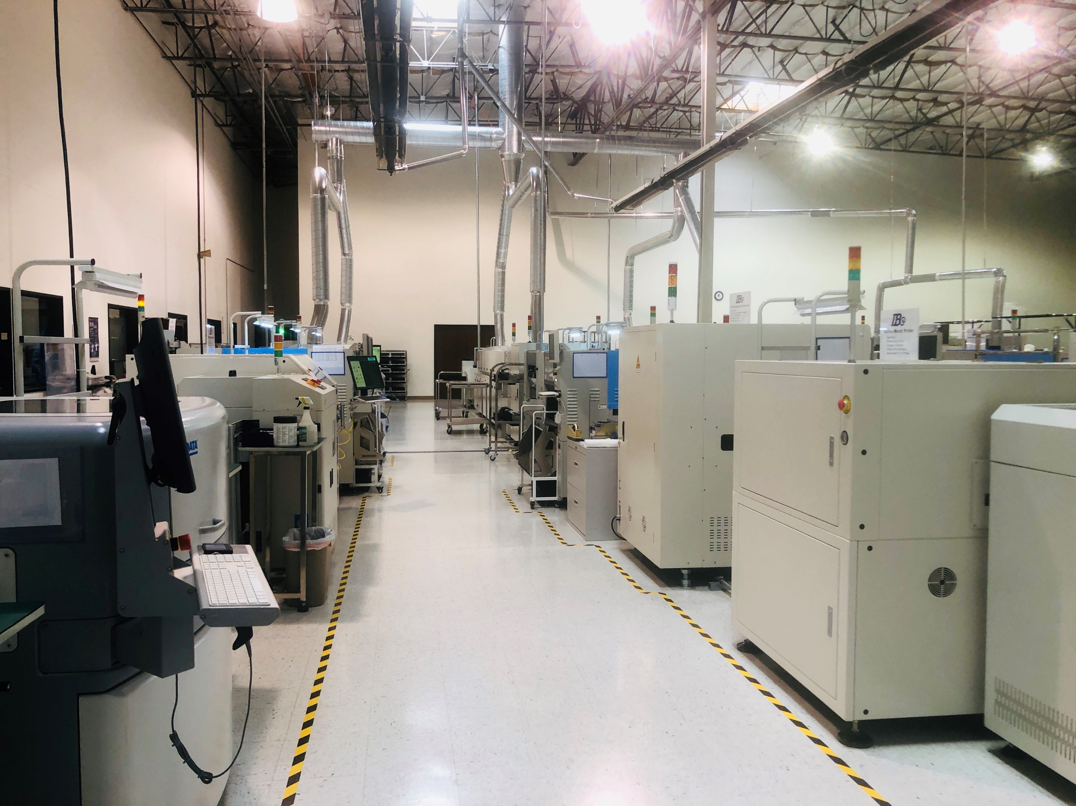
Capabilities Manufacturing Services – Production Facilities
MBA Electronics
2 – Hand solder lines
4 - SMT Lines
• Single or Double sided placement
• 0402 and 0201 component placement
• BGA and Micro BGA Assembly
1 – Quick-turn SMT Line

Slide 17
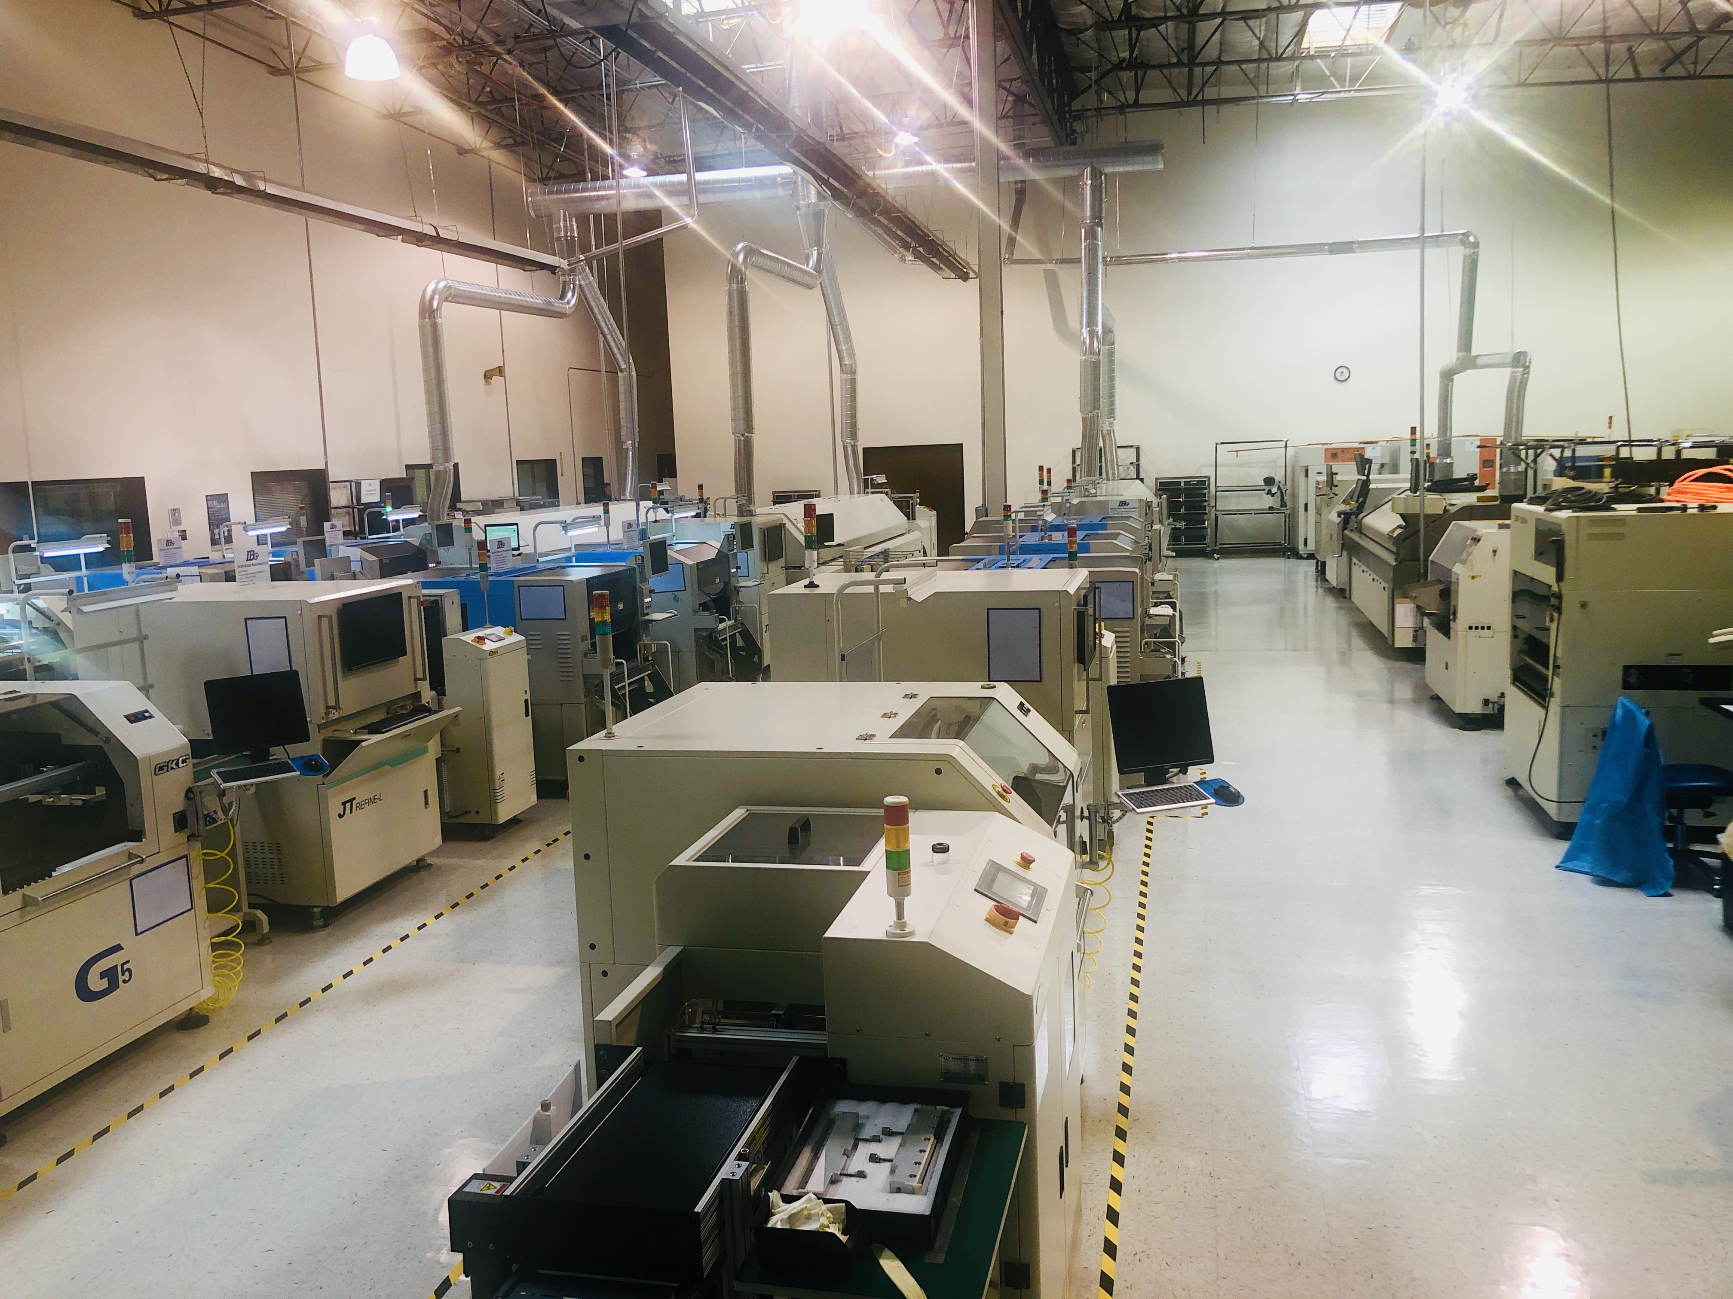
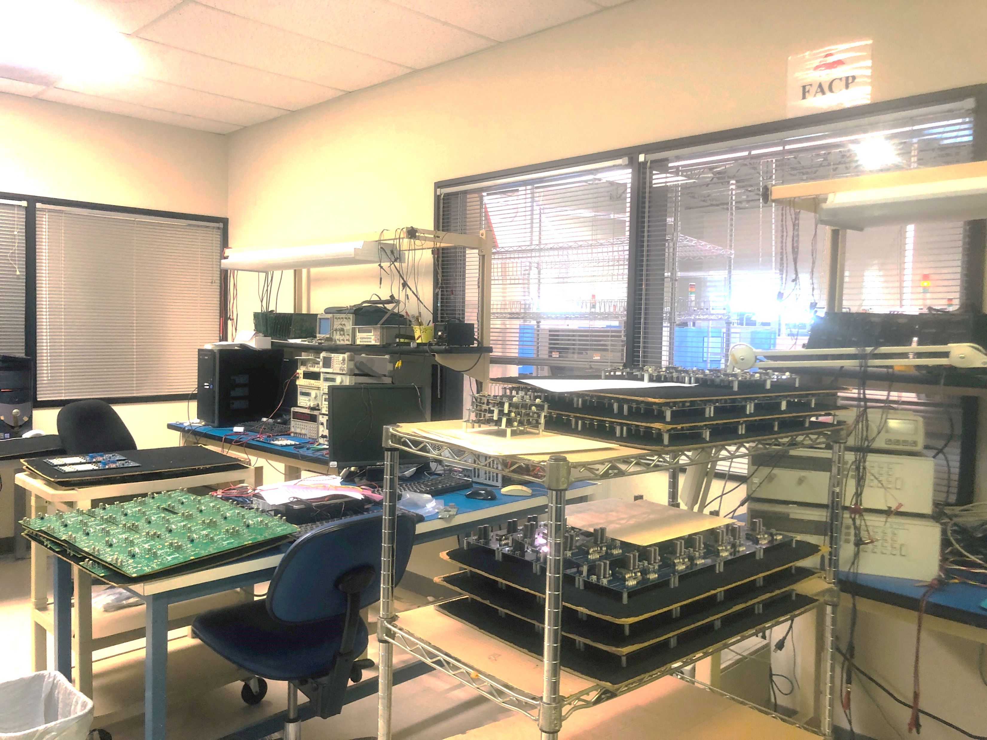
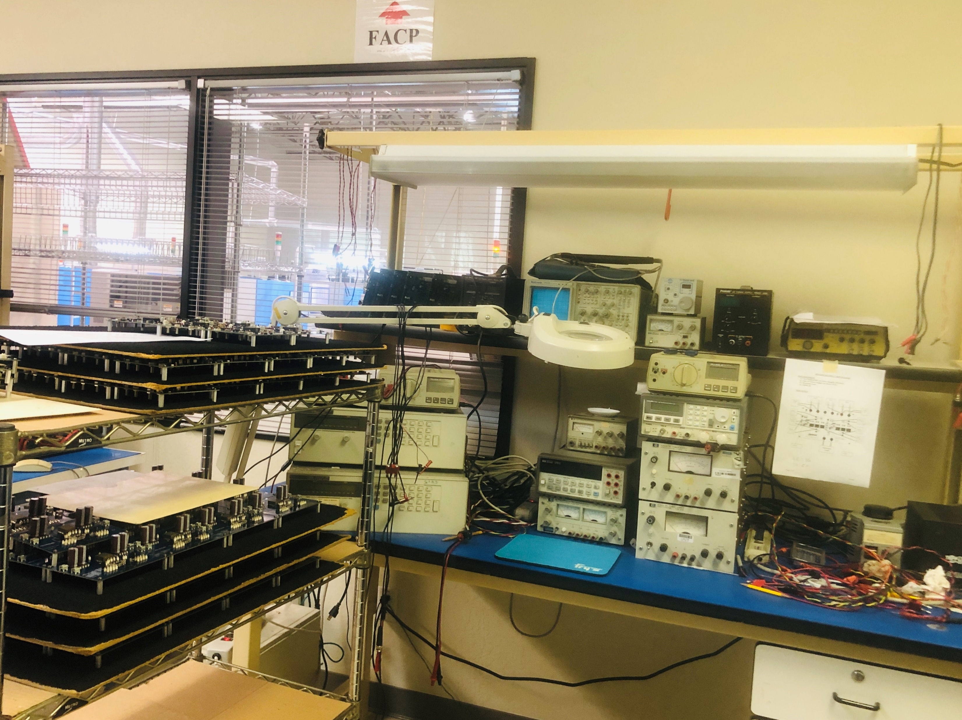
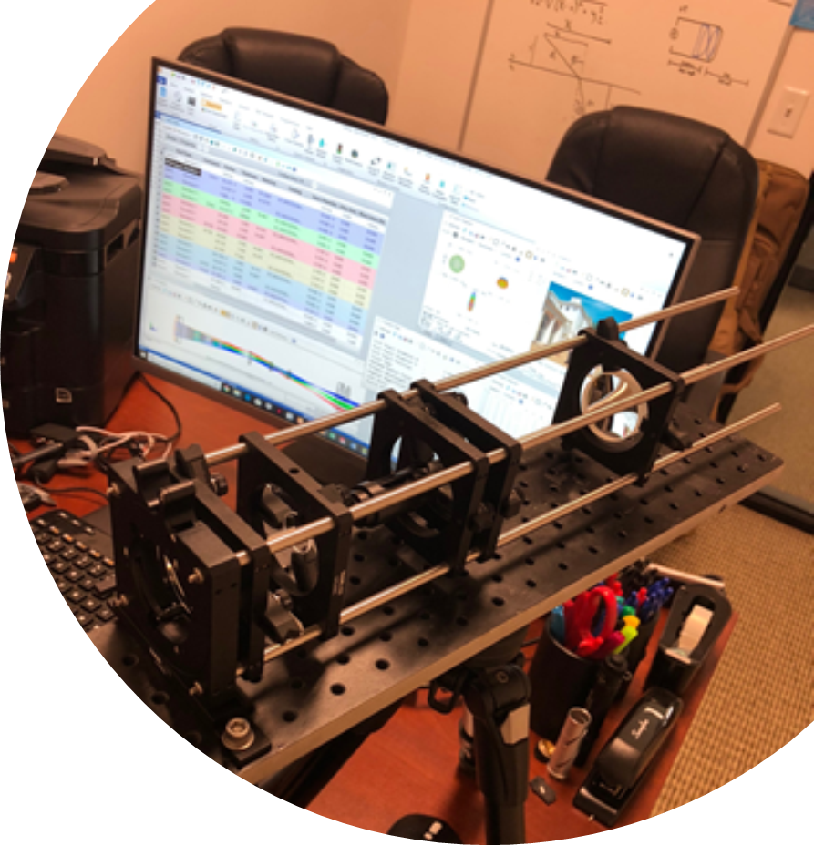
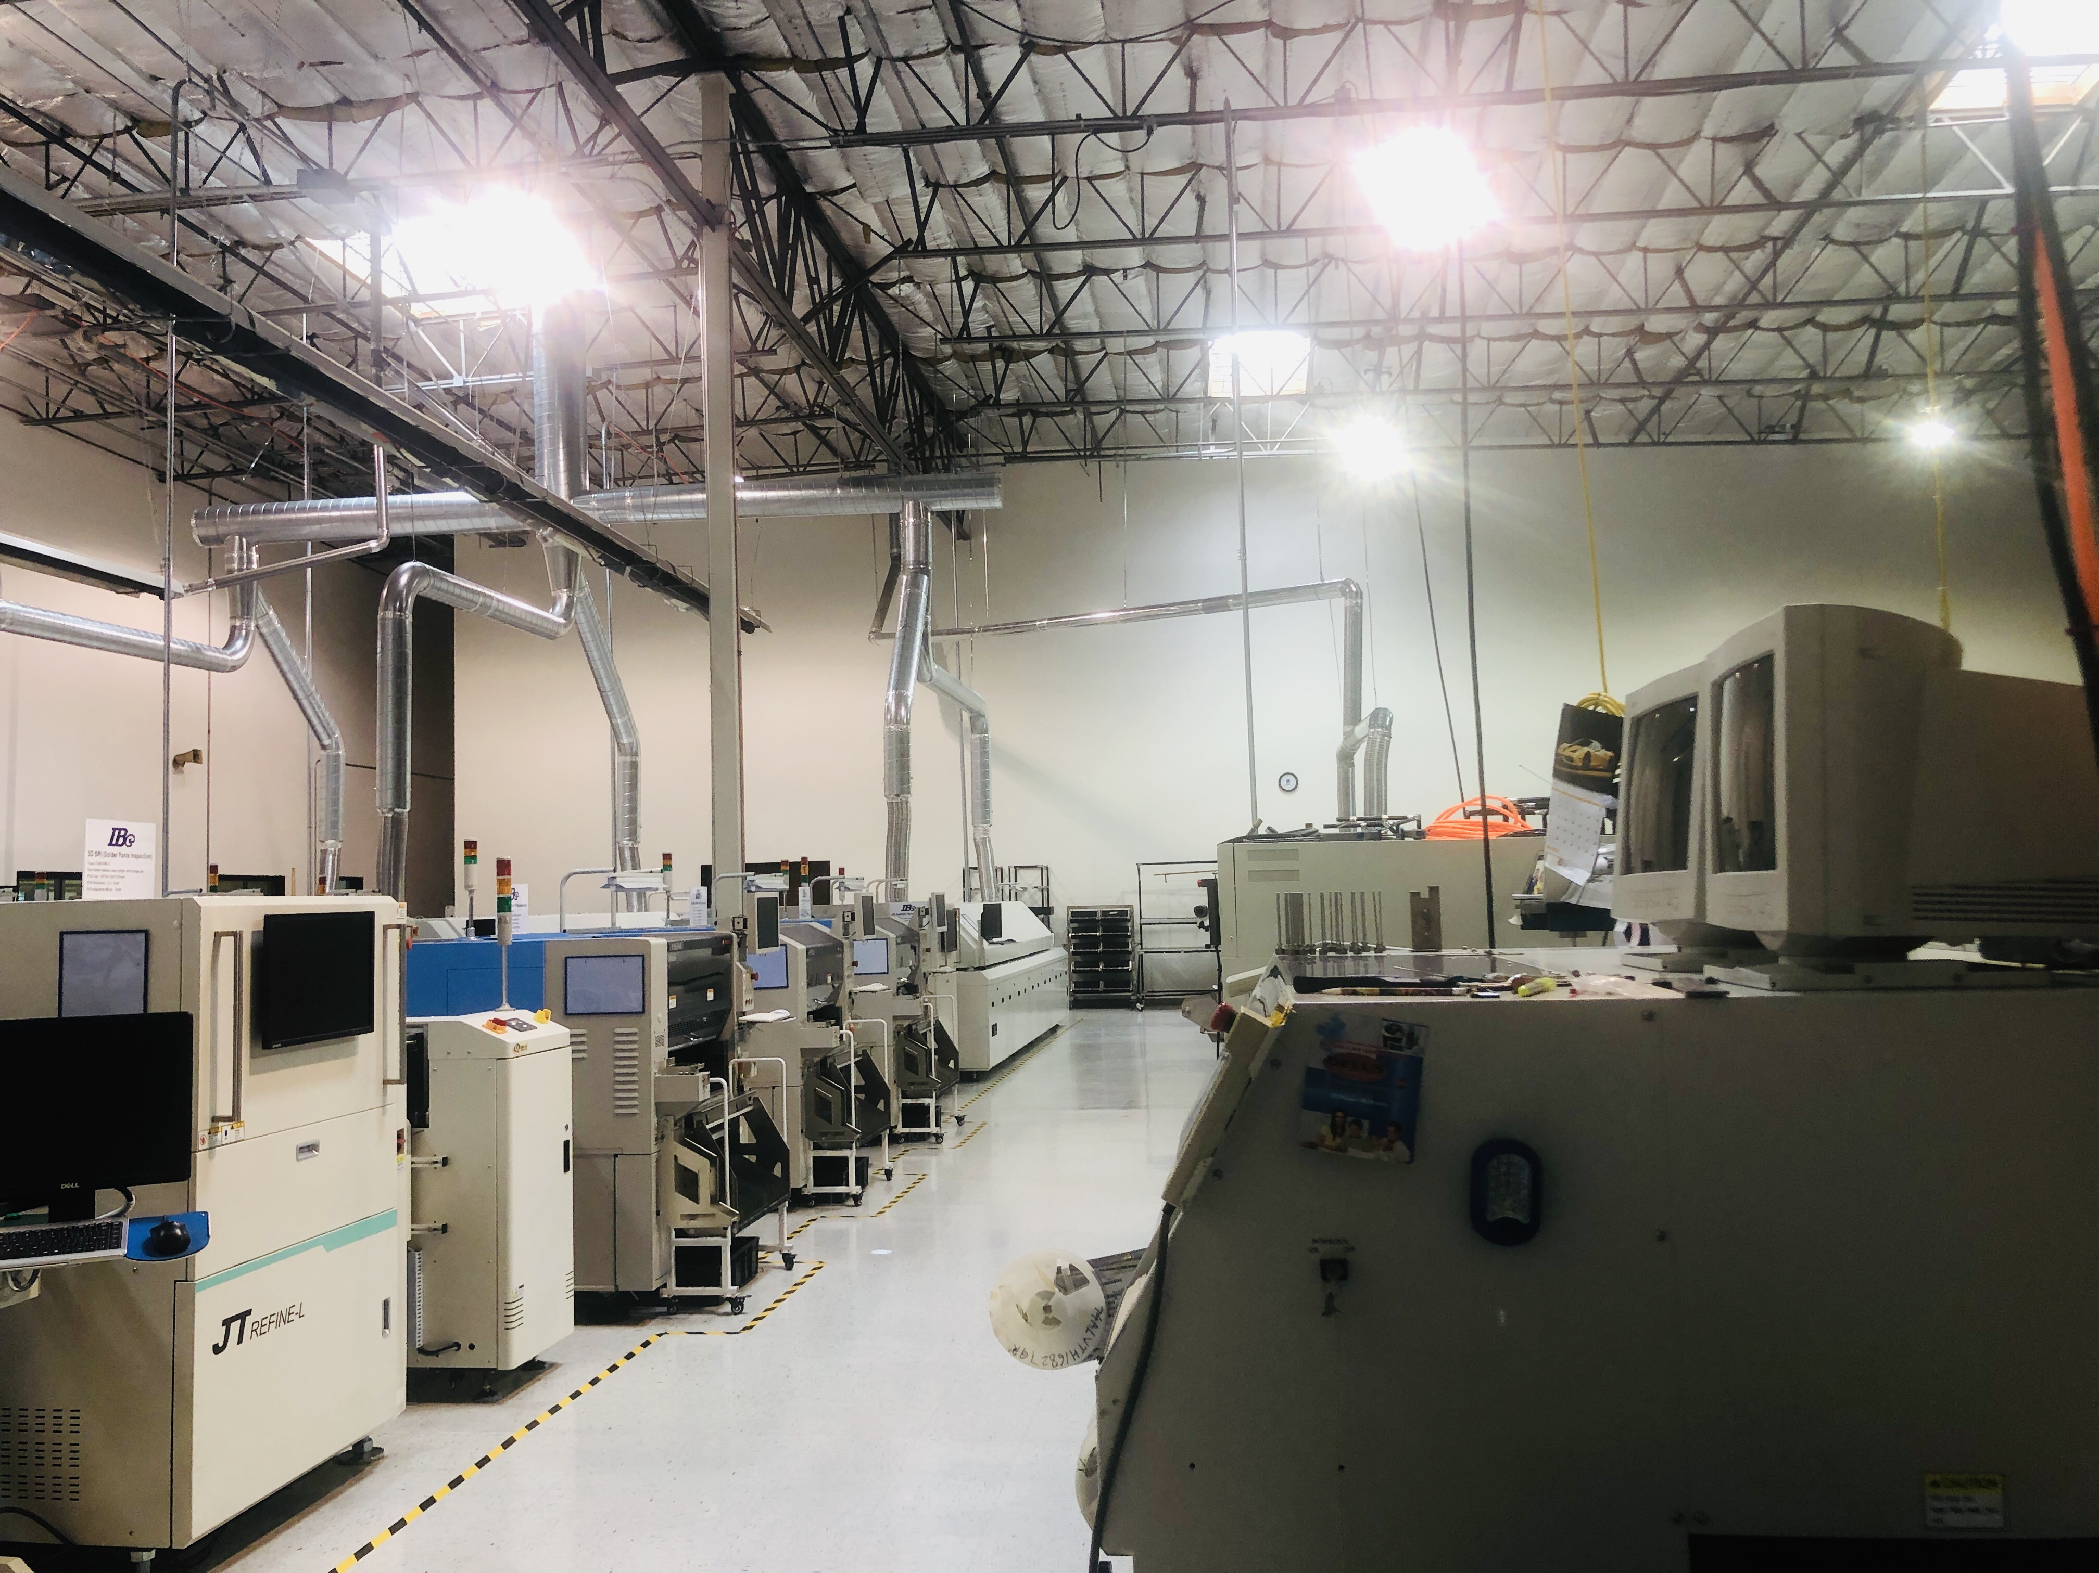
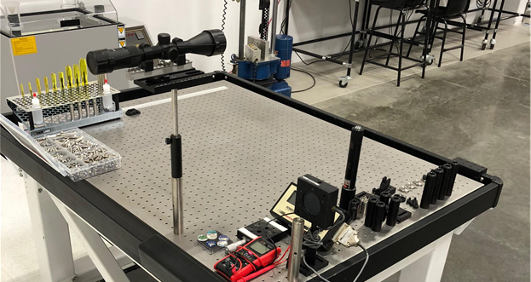
Capabilities Manufacturing Services – Production Facilities
MBA Electronics Manufacturing & Design
Functional Testing
SMT Lines & Line Testing
Design Support

Slide 18
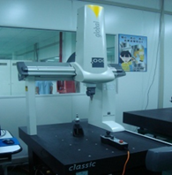
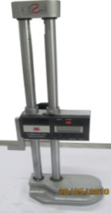
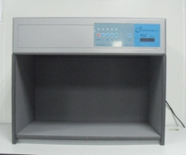
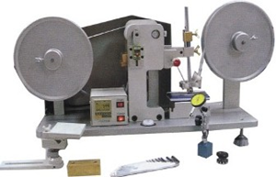
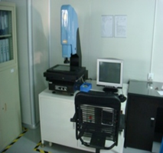
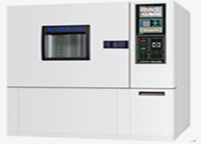
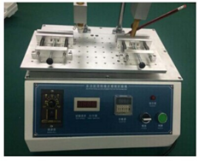
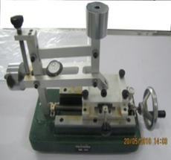
Capabilities Manufacturing Services – Inspection & Reliability
In-house testing to ensure the highest quality.
3D Coordinate measuring machine (CMM)
-Fully trained & certified technicians
-Calibration upkeep
Light Box (UV Testing)
RCA Abrasion wear test
Height Gauge
2.5D Coordinate measuring machine
-Fully trained & certified technicians
-Calibration upkeep
Temp/Humidity Test
Alcohol Rub Friction Test
Hardness Tester

Slide 19
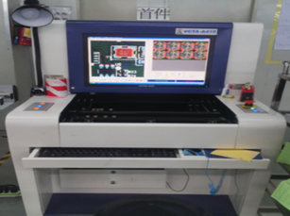
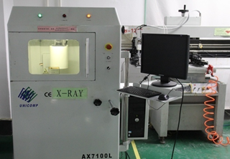
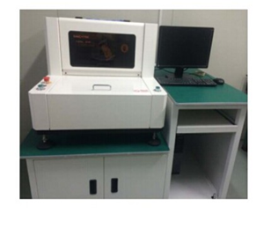
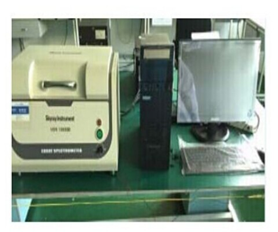
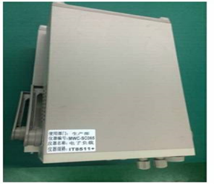
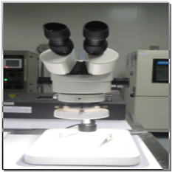
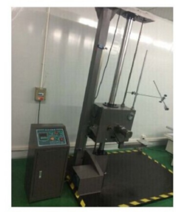
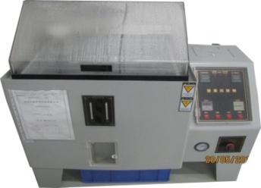
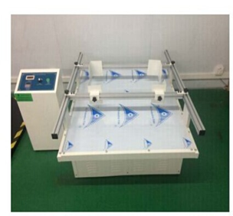
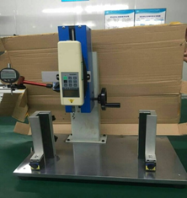
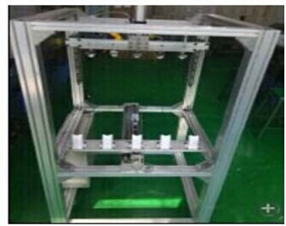
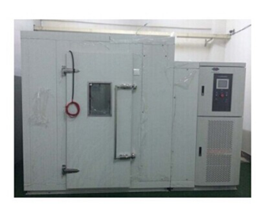
Capabilities Manufacturing Services – Inspection & Reliability
Additional In-house testing to ensure the highest quality.
AOI Machine
X-Ray Machine
3D SPI Station
X-Ray Spectrometer
For RoHS
Electronic Loading
Instrument
Microscopes
MBA Electronics core focus, outside of manufacturing the product is; Product Reliability testing. MBA adopts a no-risk policy when It comes to shipping product to our customers.
Impact / Drop
Testing (G-force)
Salt-fog Tester
Packaging
Vibration Tester
Push/Pull Test
Dynamic Pull-test
Fixture
Low/High Temp
Chamber Testing

Slide 20
Key Advantages
High-Quality Product, with competitive pricing, flexibility and support.
QUALITY
Dedicated production line, testing, certification and local US goods storage, prototyping.
DEDICATION
Full-Turnkey Product Solution, both manufacturing & design.
SOLUTIONS
Global Supply chain, management and customer support
GLOBAL
Quick-prototyping, 1st articles and technology transfers
TECHNOLOGY
Long-term cooperation expectations, valued partnerships
LONG-TERM PARTNERSHIP

Slide 21
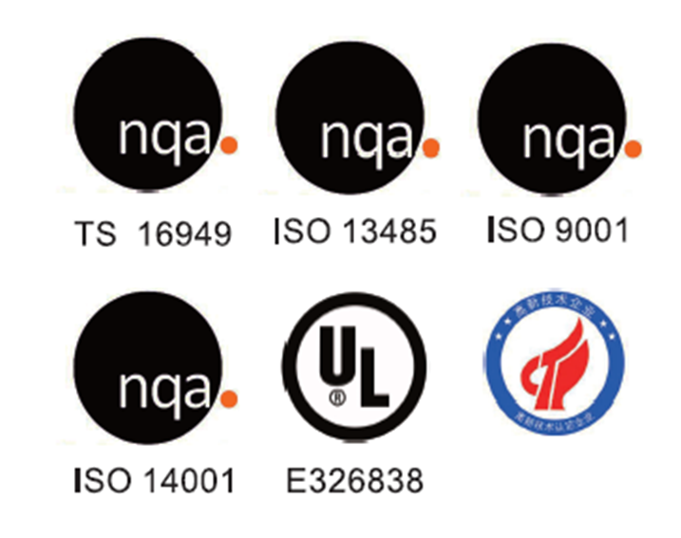
References & Certifications

Slide 22
MBA
A IBe Electronics Company
Direct Customer Support Team
Adam Nemeyer
Business Development Manager
Angel Xu
President – MBA Electronics
Kevin Wu
Business Development Director
MBA Electronics, USA (Oregon)
Sales & Customer Support
2807 SE 75th Hillsboro, OR 97123
Contact Tel: +1.971.371.1144
Email: adam@mbaelectronics.com
www.MBA-SV.com
MBA Electronics, USA (California)
California SMT Services
40760 Encyclopedia Cir Fremont, CA, 94538
Contact Tel: +1.510.226.9089
Email: Angel@mbaelectronics.com
www.MBA-SV.com
IBE Electronics, China (Parent Company)
Shenzhen SMT/Turnkey and Design Center
Tangtou Industry District，Shiyan Town
Bao'an District，Shenzhen，China 518108
Contact Tel: +86-15889700608
Email: kevin@pcbaaa.com
www.pcbaaa.com

